Slide 1

Project Title - AI-Based Network Intrusion Detection System (NIDS)
[Yash Sahu]
[AICTE ID : STU66ae7b62585ef1722710882]

Slide 2

PROBLEM STATEMENT
Primary Goal: To detect DDoS (Distributed Denial of Service) attacks
using machine learning.
Explainability: Integrating Large Language Models (LLMs) to provide
human-readable explanations of technical network data.
Interactive Simulation: Developing a dashboard to simulate "capturing"
and analyzing network packets.

Slide 3
Project Description
[write detail description about your project ]
Data Layer: Processes the Friday-WorkingHours-Afternoon-DDos.pcap_ISCX.csv dataset.
Classification Layer: Implements a Scikit-Learn Random Forest model to identify threats.
Interpretation Layer: Utilizes the Groq API (Llama-3.3-70b) to explain packet anomalies.
Interface Layer: A Streamlit-based web dashboard for real-time simulation.

Slide 4

WHO ARE THE END USERS?
Cybersecurity Students & Educators: Since the project is explicitly labeled as a "Student Project," the primary users are students learning to bridge the gap between machine learning theory and practical network security. It serves as a teaching tool to show how algorithms like Random Forest can be applied to real-world datasets like CICIDS2017.
Junior Security Analysts (L1 Analysts): The "AI Analyst" feature (powered by Groq) is designed to simplify complex network headers into "short and simple" explanations. This makes it a valuable tool for junior analysts who can identify a threat but may not yet fully understand the significance of specific technical metrics like Flow IAT or Packet Length.
Security Research & Development Teams: Developers looking for a Proof of Concept (PoC) on how to integrate Large Language Models (LLMs) with traditional detection systems would use this to understand the implementation of "Explainable AI" in network monitoring.

Slide 5

Technology Used
Language: Python
Machine Learning: Scikit-Learn (Random Forest)
Generative AI: Groq Cloud API (Llama-3.3-70b-Versatile)
Interface: Streamlit
Data Handling: Pandas & NumPy
Dataset: CIC-IDS2017 (DDoS Subset)

Slide 6
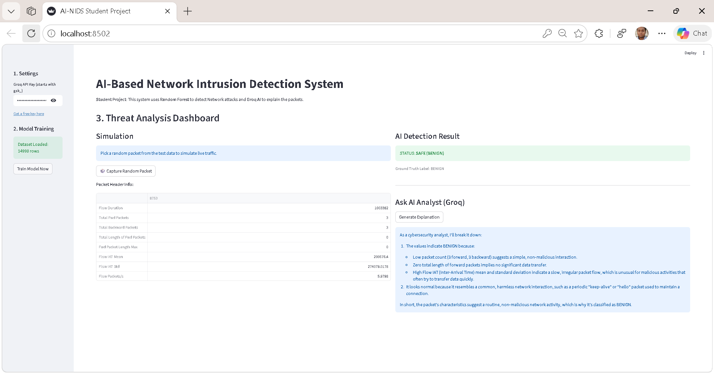
RESULTS

Slide 7

Certificate - Protection from browser attacks

Slide 8
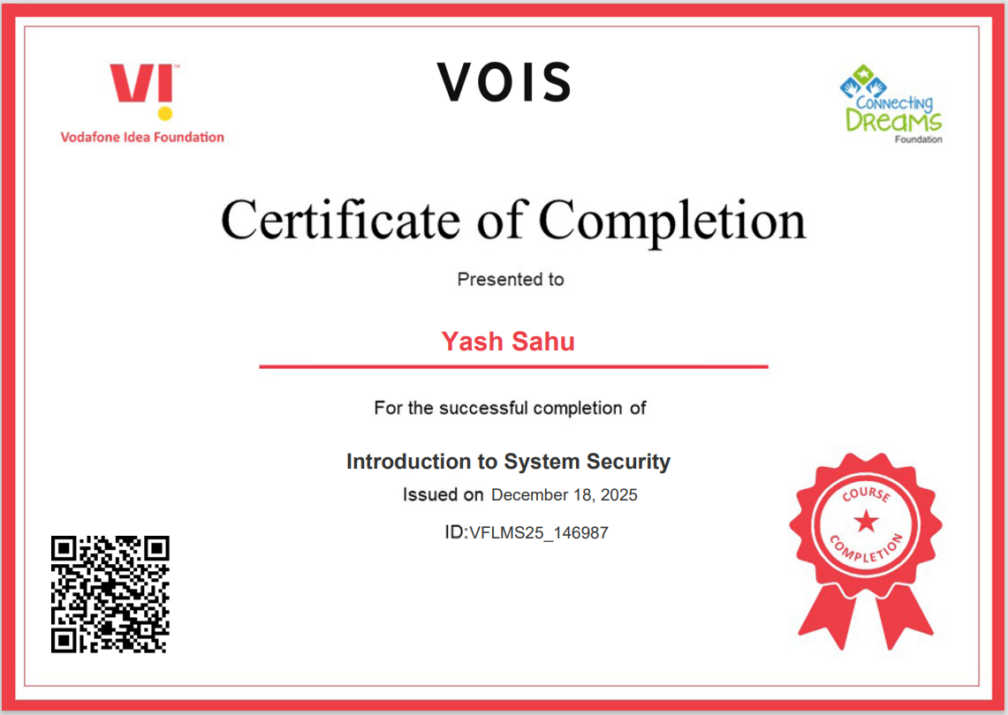
Certificate - Introduction to System Security

Slide 9

Certificate - Securing Android Devices

Slide 10
GitHub link
https://github.com/yashsahu2001/DDoS-Project.git

Slide 11
Thank you
Thank You
.
.

